Slide 1
Substance Abuse Basics
Berkshire County Sheriff’s Office
Nancy Reis, LADC I, MATC, FAC
– Substance Use Clinician-

Slide 2
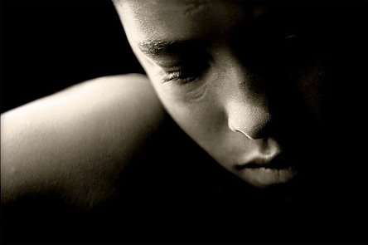
Depressants/Downers
Any of several drugs that sedate by acting on the central nervous system (CNS):
medical uses include the treatment of
anxiety
tension
pain management
symptom management
high blood pressure
Sleep issues

Slide 3
Alcohol Withdrawal
An intoxicated person who is admitted to jail often requires medical treatment; symptoms of intoxication can be (but are not limited to):
Tremors
overly alert
nervous
shakiness
weakness
delusions/hallucinations
flushed face
loss of appetite
rapid heart beat
disordered perceptions
Notes:
Staff responsibilities
15 minute checks
follow your P & P
If you don’t know it or are new to a post, read it, review with a supervisor or senior staff member
Photo is often used in police custody situations
Some jails are used as or are part of regional lock ups
Librium is used as a method of detoxification from alcohol to assist in limiting seizures. This means the inmate will test positive for benzos

Slide 4
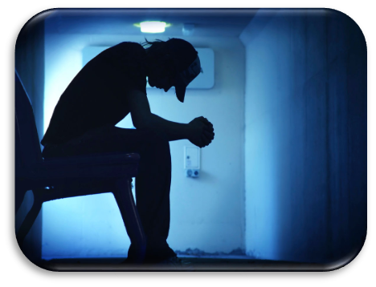
Notes:
Diaphoresis – symptomatic profound sweating
Tonic clonic seizure (also known as grand mal) tonic phase the body becomes entire rigid. In the clonic phase there is uncontrolled jerking.
Tachycardia – abnormally rapid heart rate (resting heart rate over 100 bpm )

Slide 5
Alcohol Withdrawal
Seizures
May occur within 7 to 48 hours after inmate has stopped drinking
Similar to epileptic seizures
Treatment
Officer should treat each as grand mal attack
Patient is provided with a second mattress for the floor for safety
If inmate does not regain consciousness or it lasts more than 2 minutes, transfer to hospital
Notes:
Staff responsibilities
15 minute checks
follow your P & P
If you don’t know it or are new to a post, read it, review with a supervisor or senior staff member

Slide 6
Alcohol Withdrawal
Auditory Hallucinations
May occur between 12 and 48 hours after inmate has stopped drinking
Inmate complains of hearing voices
Treatment
This can be considered a medical emergency and the nurse on duty should be called immediately
Notes:
Staff responsibilities
15 minute checks
follow your P & P
If you don’t know it or are new to a post, read it, review with a supervisor or senior staff member

Slide 7
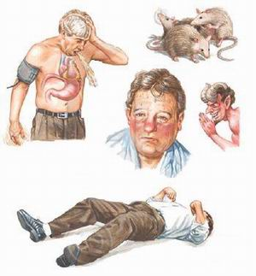
Alcohol Withdrawal
DT’s (delirium tremens)
Delirium tremens is a severe form of alcohol withdrawal.
Typically seen in people with histories of long term, heavy consumption of alcohol.
The whole body trembles, sometimes with seizures, disorientation, and hallucinations.
Symptoms most commonly occur within 48 – 96 hours after last drink but can occur 7 – 10 days after the last drink.
Delirium tremens lasts 3 – 10 days, with a reported death rate of up to 20%.
Hallucinations may develop independently of delirium tremens and may last days to weeks.
May also be caused by head injury, infection or illness.
Notes:
Staff responsibilities
15 minute checks
follow your P & P
If you don’t know it or are new to a post, read it, review with a supervisor or senior staff member
Photo is often used in police custody situations
Some jails are used or are part of regional lock ups
Librium is used as a method of detoxification from alcohol to assist in limiting seizures. This means the inmate will test positive for benzos

Slide 8
Alcohol Withdrawal – DT’s
Symptoms
profound confusion
vivid hallucinations
agitation
increased pulse & breathing
possible terror or confusion
delusions
tremors
pallor
sweating
vomiting
high fever with convulsions
Treatment
Transfer inmate to hospital immediately
Officer may need to administer First Aid for convulsions and fever
If inmate is admitted to jail infirmary, medical staff will:
monitor closely
keep well hydrated
Notes:
Staff responsibilities
15 minute checks
follow your P & P
If you don’t know it or are new to a post, read it, review with a supervisor or senior staff member
Photo is often used in police custody situations
Some jails are used or are part of regional lock ups
Librium is used as a method of detoxification from alcohol to assist in limiting seizures. This means the inmate will test positive for benzos

Slide 9
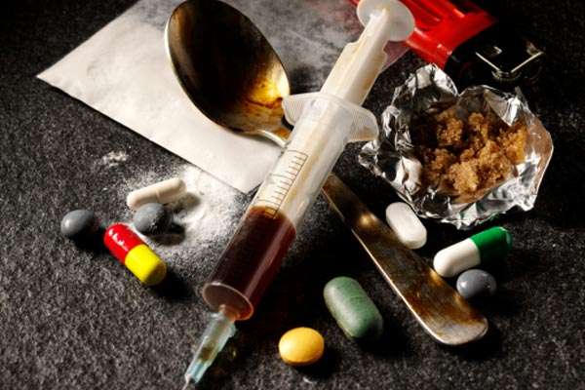
Most Common Categories of Drugs Besides Alcohol
Cannabis: marijuana, extracts, hash (THC/CBD)
Stimulants/Uppers: cocaine, amphetamines (Adderall), methylphenidate (Ritalin) methamphetamine, MDMA (ecstasy/molly),
Depressants/ Sedatives
Opioids: Heroin, Methadone, Buprenorphine, morphine, Codeine, Tramadol, Fentanyl, Carfentanyl
Benzodiazepines: Xanax, Klonopin, Ativan, Valium, Librium
Barbiturates: prescription drugs with Phenobarbital in them
PCP: Phencyclidine (angel dust)
Notes:
CBD is said to have some beneficial properties like anti-anxiety, anti-convulsive, anti-psychotic, anti-rheumatoid, anti-nausea and other sedatives substances.
CBN or Cannabinol is the next form of THC. This chemical is formed after THC meets light and oxygen. This cannabinol has the slight psychoactive effects with the stronger effect than the THC. This chemical has the ability of anti-epileptic and anti-spasmodic.
Cannabichromene or CBC is popular for its anti-inflammatory and anti-viral ability. It also contributes to the analgesic effect of medical marijuana. Based on the research, CBC can potentially stop the growth of cancerous tumors. This can be done due to CBC interaction with the anandamide, the endocannabinoid popularly known to stop breast cancer.
Klonopin – aka clonazepam ; Ativan aka Lorazepam ; Tramadol aka Ultram,
(MDMA) is a derivative of amphetamine and a member of the phenethylamine family of chemicals that may act as stimulants, hallucinogens, and/or entactogens. MDMA is a synthetic drug that acts as a stimulant and hallucinogen.
Empathogens or entactogens are a class of psychoactive drugs that produce experiences of emotional communion, oneness, relatedness, emotional openness—that is, empathy or sympathy—as particularly observed and reported for experiences with 3,4-methylenedioxymethamphetamine.
DMT = Dimethyltriptamine
DIPT= Diisopropyltryptamine
Are Ritalin and Adderall the same?
Not as far as ingredients go. Ritalin is a brand name for methylphenidate and Adderall contains mixed amphetamine salts.^{1,2} Although they contain different ingredients, they are both classified as CNS stimulants and are thought to work in a similar way – by increasing the concentrations of norepinephrine and dopamine in the brain.

Slide 10
Most Common Categories of Drugs Besides Alcohol
Other Pharmaceuticals:
Soma (Carisoprodol)
Ambien (Zolpidem) – “ambo”
Gabapentin (Neurontin) - “Johnnies”
Wellbutrin (Bupropion) - “Wellies
Seroquel (Quetiapine) – “Q”, “Squirrel”
Lyrica (Pregabalin)
Psychedelics: LSD, Mescaline, Psilocybin, DMT, DIPT, 2C-E/2C-I, DXM
Notes:
Soma = muscle relaxant/ sedative
Ambien = GABA Agonist . Used by fighting off the sleep and/or exceeding therapeutic dosage accessing the hypnotic effects
Lyrica = Street use/abuse still relatively low but appears to be increasing
Neurontin = Analgesic, anti seizure agent. Users claim it to have a high similar to etoh, opiates or Lyrica .
Welbutrin =antidepressant (not an SSRI but similar), “poor man’s cocaine” – Toronto 2013 Global News
Seroquel = often prescribed in institutional settings and diverted for recreational use.
Psychedelics – although LSD is still available more often other designer drugs that are cheaper, easier to make are passed off as something more well known.
Often times MDMA and PVP drugs are used for their hallucinogenic properties although not fundamentally considered psychedelics. PCP is also considered a psychedelic.
DiPT (5-methoxy-N, N-diisopropyltryptamine, often abbreviated as 5-MeO-DIPT) is a hallucinogenic drug that has a number of similarities with other drugs in this class. It is sometimes known on the street as foxy, and a very close analog of the drug is known as moxy or foxy-moxy.
DiPT is a derivative of tryptamine, which is a monoamine and similar to the amino acid tryptophan. Tryptamine is a trace element found in the brains of mammals, including humans, and it is believed to be a neurotransmitter or a neuromodulator (a substance that affects the release of other neurotransmitters in the central nervous system).
DiPT has no currently accepted medicinal uses in the United States, although some sources suggest that it may have some neurological and psychiatric uses. It remains classified as a Schedule I controlled substance by the United States Drug Enforcement Administration (DEA), indicating that it is illegal to possess in any form except for special cases where it is used in research. Special permissions from the government are required to possess and use substances in this class. DiPT has a number of hallucinogenic effects that make it somewhat popular among users of hallucinogenic drugs. According to the DEA, in animal studies, the drug is shown to have similar effects to drugs like LSD, DMT, and psilocybin.
According to information provided by the DEA, the drug may be often used as a substitute for the rave drug MDMA. DiPT can be taken orally as a powder or in tablets or capsules. It can be snorted, smoked, and may even be injected in some cases. The powder form of th
2C-E and other drugs in the 2C family have hallucinogenic effects similar to those of LSD and ecstasy (MDMA). The synthetic drugs, often used at music festivals, clubs and parties, can also cause extreme elevations in body temperature, psychosis, delirium and even death.e drug varies in color.

Slide 11
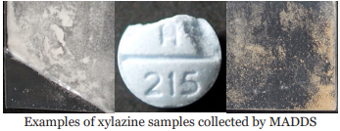
Most Common Categories of Drugs Besides Alcohol
Xylazine
(also called “tranq” or “tranq dope”) is a non-opioid sedative or tranquilizer. Although not a controlled substance in the United States, xylazine is not approved for use in people.
More prominent in Berkshire County than anywhere else in Massachusetts, according to new statewide data.
“DEA has seized xylazine and fentanyl mixtures in 48 of 50 States. The DEA Laboratory System is reporting that in 2022 approximately 23% of fentanyl powder and 7% of fentanyl pills seized by the DEA contained xylazine. – dea.gov
Notes:
Massachusetts Drug Supply Stream (MADDS)- Brandeis University

Slide 12
Most Common Categories of Drugs Besides Alcohol
Xylazine
Xylazine is an active cut in other drugs, primarily opioids, and people may not know that their drugs contain xylazine, which is why it’s important to be aware of the harmful effects of xylazine, including oversedation, skin ulcers, infection, and other serious injuries.
Xylazine and naloxone: Xylazine can contribute to oversedation alongside opioids. Naloxone WILL NOT reverse the effects of xylazine, but ALWAYS administer naloxone in a suspected overdose. Naloxone will reverse the effects of any opioids present. The person may remain unresponsive if xylazine is present. Give rescue breaths to support their breathing.
What are symptoms and health risks of xylazine?
Sedation
difficulty breathing
dangerously low blood pressure
slowed heart rate
wounds that can become infected
severe withdrawal symptoms
death
Notes:
Neurontin = Analgesic, anti seizure agent. Users claim it to have a high similar to etoh, opiates or Lyrica .
Welbutrin =antidepressant (not an SSRI but similar), “poor man’s cocaine” – Toronto 2013 Global News
Seroquel = often prescribed in institutional settings and diverted for recreational use.
Psychedelics – although LSD is still available more often other designer drugs that are cheaper, easier to make are passed off as something more well known.
Often times MDMA and PVP drugs are used for their hallucinogenic properties although not fundamentally considered psychedelics. PCP is also considered a psychedelic.
DiPT (5-methoxy-N, N-diisopropyltryptamine, often abbreviated as 5-MeO-DIPT) is a hallucinogenic drug that has a number of similarities with other drugs in this class. It is sometimes known on the street as foxy, and a very close analog of the drug is known as moxy or foxy-moxy.
DiPT is a derivative of tryptamine, which is a monoamine and similar to the amino acid tryptophan. Tryptamine is a trace element found in the brains of mammals, including humans, and it is believed to be a neurotransmitter or a neuromodulator (a substance that affects the release of other neurotransmitters in the central nervous system).
DiPT has no currently accepted medicinal uses in the United States, although some sources suggest that it may have some neurological and psychiatric uses. It remains classified as a Schedule I controlled substance by the United States Drug Enforcement Administration (DEA), indicating that it is illegal to possess in any form except for special cases where it is used in research. Special permissions from the government are required to possess and use substances in this class. DiPT has a number of hallucinogenic effects that make it somewhat popular among users of hallucinogenic drugs. According to the DEA, in animal studies, the drug is shown to have similar effects to drugs like LSD, DMT, and psilocybin.
According to information provided by the DEA, the drug may be often used as a substitute for the rave drug MDMA. DiPT can be taken orally as a powder or in tablets or capsules. It can be snorted, smoked, and may even be injected in some cases. The powder form of th
2C-E and other drugs in the 2C family have hallucinogenic effects similar to those of LSD and ecstasy (MDMA). The synthetic drugs, often used at music festivals, clubs and parties, can also cause extreme elevations in body temperature, psychosis, delirium and even death.e drug varies in color.

Slide 13
Benzodiazepine Overdose
What are the signs and symptoms of a benzodiazepine overdose?
Extreme drowsiness or trouble staying awake
Slurred speech or confusion
Agitation
Lack of muscle coordination
Coma

Slide 14
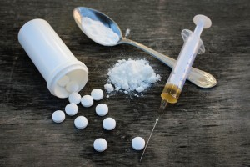
Opiates/Opioids
Organic/Natural
Opium
Morphine
Codeine
Semi-synthetic
Heroin
Hydrocodone
Oxycodone
Hydromorphone
Oxymorphone
Buprenorphine
Synthetic
Meperidine
Fentanyl (W-18)
Methadone
Notes:
Heroin = synthesized from morphine
Hydrocodone (Zohydro, Vicodin, Loritab) = partial synthetic
Oxycodone – Roxicodone, Percocet. Most commonly abused currently as “perc 30’s” . Different than typical Percocet due to the absence of Tylenol/acetaminophen .
Oxycontin is actually a form of oxycodone aka “Oxies” or OC’s
Hydromorphone – Dilaudid
Oxymorphone – Opana
Meperidine –Demerol
Fentanyl – Synthetic
W-18 – Research chemical recently (spring 2016) in some street heroin in Canada and sparsely in the USA
Methadone - Dolophine

Slide 15
Opioids – most commonly abused
Organic
Opium
Morphine
Codeine
Semi-synthetic
Heroin
Hydrocodone
Oxycodone
Hydromorphone
Oxymorphone
Buprenorphine
Synthetic
Meperidine
Fentanyl
Methadone
Notes:
Heroin = synthesized from morphine
Hydrocodone (Zohydro, Vicodin, Loritab) = partial synthetic
Oxycodone – Roxicodone, Percocet. Most commonly abused currently as “perc 30’s” . Different than typical Percocet due to the absence of Tylenol.
Oxycontin is actually a form of oxycodone aka “Oxies” or OC’s
Hydromorphone – Dilaudid
Oxymorphone – Opana
Meperidine –Demerol
Fentanyl – Synthetic
W-18 – Research chemical recently (spring 2016) in some street heroin in Canada and sparsely in the USA
Methadone - Dolophine

Slide 16
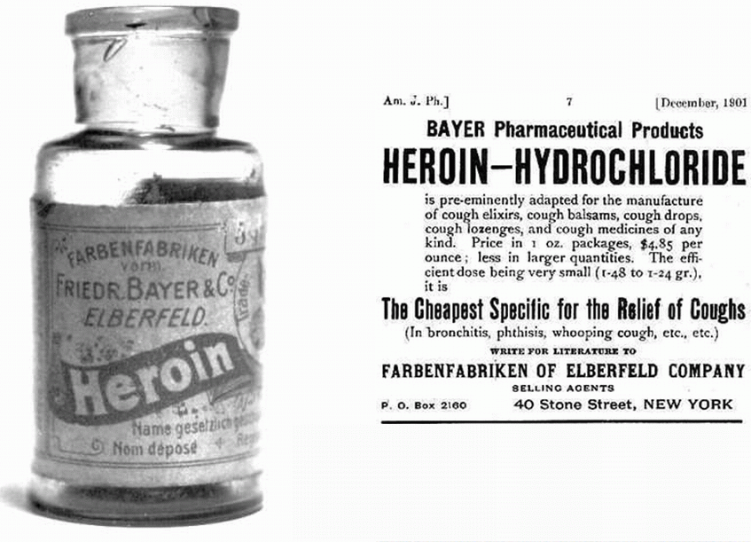
Notes:
In the northeast heroin is typically an off white powder

Slide 17
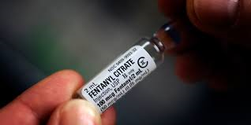
Fentanyl
Schedule II drug
Opioid analgesic, first synthesized in Belgium in the late 1950s
analgesic potency of about 80 times that of morphine
It was introduced into medical practice in the 1960s as an intravenous anesthetic now produced as a transdermal patch, sublingual lozenge and transmucosal stick
IV, Ingested Orally, Transdermally, Snorted or Smoked
Notes:
Fentanyl is 50-100X stronger than morphine.

Slide 18
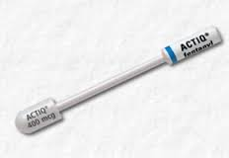
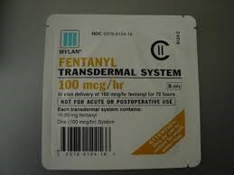
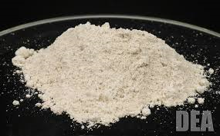
Fentanyl
The biological effects of fentanyl are indistinguishable from those of heroin, with the exception that the fentanyl may be many times more potent
Sometimes mixed with or sold as heroin

Slide 19
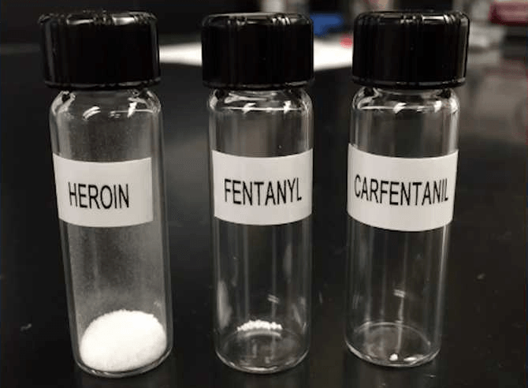
Notes:
Lethal Dose

Slide 20
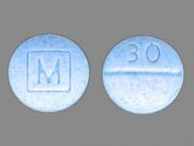
Perc 30/Blues/Blueberries
30-milligram dose of the painkiller oxycodone
Cheaper than other varieties of oxycodone and doesn’t carry the stigma of heroin use.
Can be ground up and snorted to produce full effect immediately.
Can be taken orally, nasally or injected

Slide 21
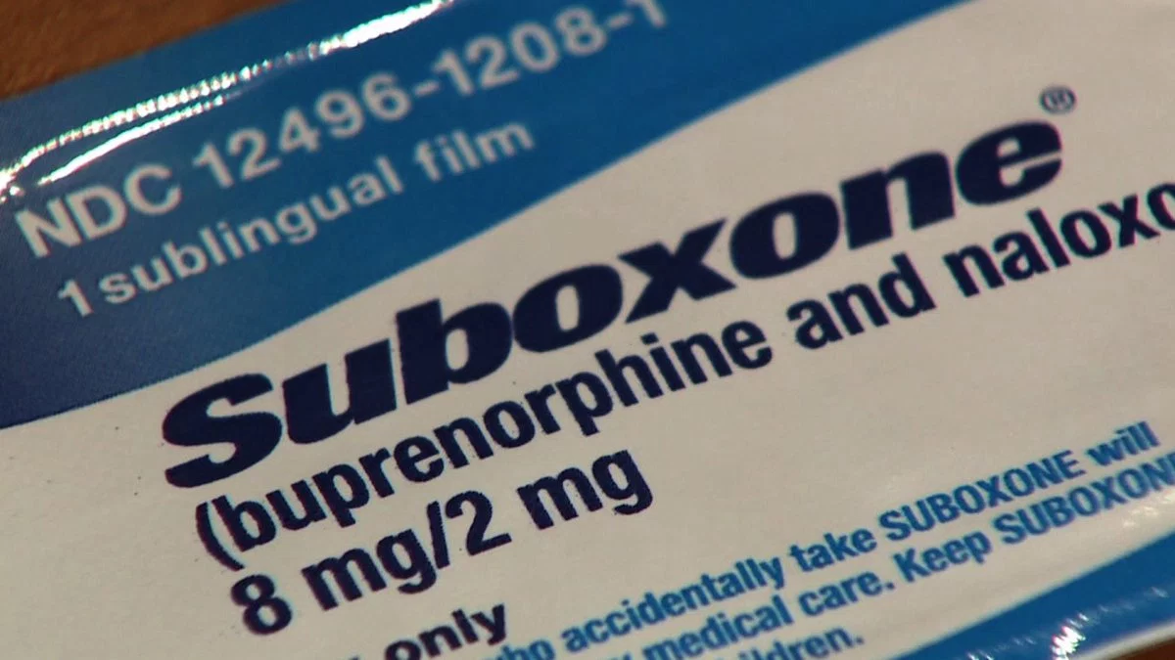
Opioids
Buprenorphine
Suboxone- Buprenorphine with naloxone
Partial Opiate Agonist with an Opiate Antagonist
Subutex has no naloxone
Subutex- Buprenorphine
Sublocade- Buprenorphine
Common diversion and abuse can occur
Notes:
Partial agonists are "keys" very much like the agonists, and they do fit in the receptors and turn them on. They are called partial agonists, however, as they can only turn these receptors on partially.
Opiate antagonists are sort of like broken keys for those opioid receptors in the brain. They fit in the opioid receptors but they do not turn them on – And significantly, while they sit in the receptor keyhole slots, other opioids cannot get in these keyholes to turn them on.
Sublocade- SUBLOCADE is injected by a treatment provider as a liquid and, once inside the body, turns to a solid gel called a depot (dee-poh).
The depot gradually releases buprenorphine at a controlled rate all month.

Slide 22
Opioids
Suboxone
Soothes opiate withdrawal symptoms
Intoxicating
“Ceiling Effect”
at a certain point (20-24mg), taking more of the drug will not increase the effects
higher affinity for mu receptors than other opiates do, and will win the fight to fill those key holes
Notes:
The ceiling effect is good in some ways. It makes Suboxone less likely attractive for abuse and far less easy to O.D. on – because of this, Suboxone can usually be taken home, saving the client from regular or even daily trips to the methadone clinic.
Once the ceiling is reached, taking a higher dosage of Suboxone won't result in increased intoxication.
Tolerance develops quickly and after several days the euphoria/intoxicating effects are negligible for most people.
It also won’t cause much risk of respiratory depression and possible overdose death.

Slide 23
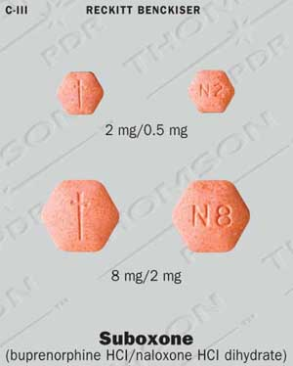
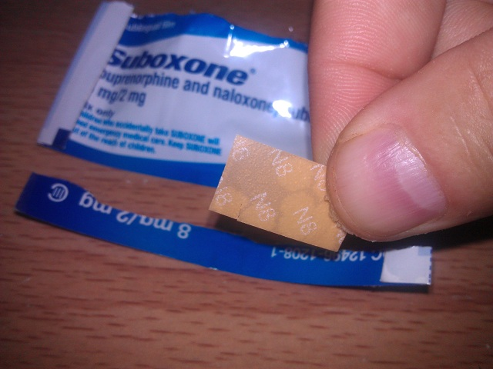
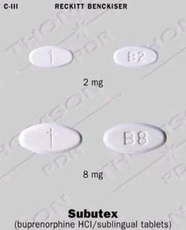

Slide 24
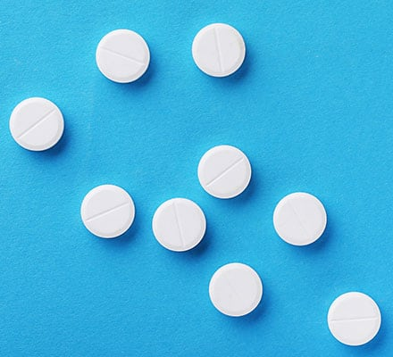

Slide 25
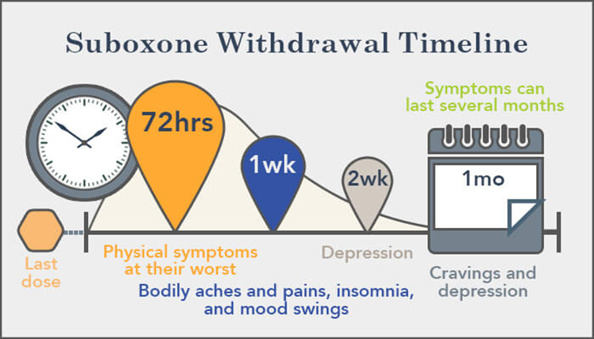

Slide 26
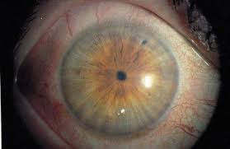
Symptoms of Opioid intoxication
Constricted/pinpoint pupils
Warm flushing of the skin
Dry mouth
Heavy feeling in the extremities
Nausea
Vomiting
Severe itching
Notes:
People often assume that those under the influence of opiates will seem heavily sedated. While this can occur at certain points of the “high” there is also a very active euphoria associated with the high. Often elevated levels of activity such as talking, socializing, cleaning etc. can be indicators of intoxication. Be aware of significant changes in behavioral or mood.

Slide 29
Withdrawal from heroin isn’t generally considered life-threatening on its own; however, some of the medical and psychological symptoms may have complications that may be life-threatening.

Slide 30
Signs of opioid Overdose
Awake but not able to respond
Body very limp
Very pale in color, ashen look to the skin
Pulse: slow, erratic, or has stopped
Blue fingertips or lips
Shallow or erratic breathing
Passed out – unresponsive to stimulation
Choking sounds or gurgling noise (“Death Rattle”
Vomiting

Slide 31
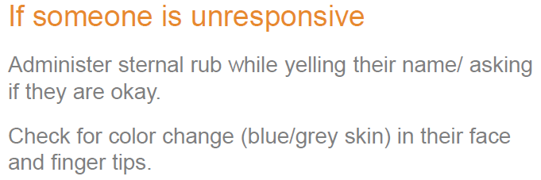
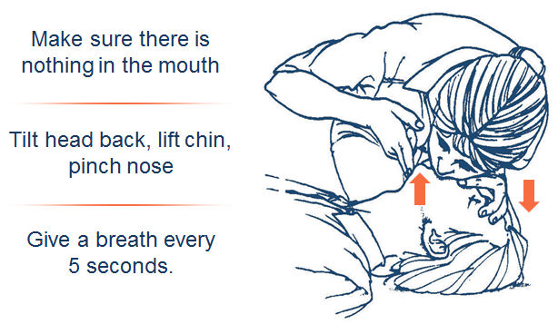
Overdose Intervention

Slide 33
Overdose Intervention

Slide 34
Overdose Intervention

Slide 35
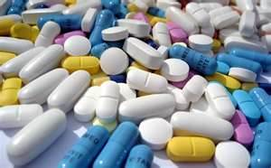
Other CNSD Withdrawal
Withdrawal Symptoms for Benzodiazepine
Convulsions, which may result in death
Catatonia, which may result in death
Delusions
Homicidal ideation
Violence
Psychosis
Mania
Effects similar to delirium tremens
Withdrawal Symptoms for Barbiturates
Weakness, restlessness, tremor, anxiety, insomnia
followed by:
Elevated blood temperature, convulsions, possible psychosis, possible coma and death

Slide 36
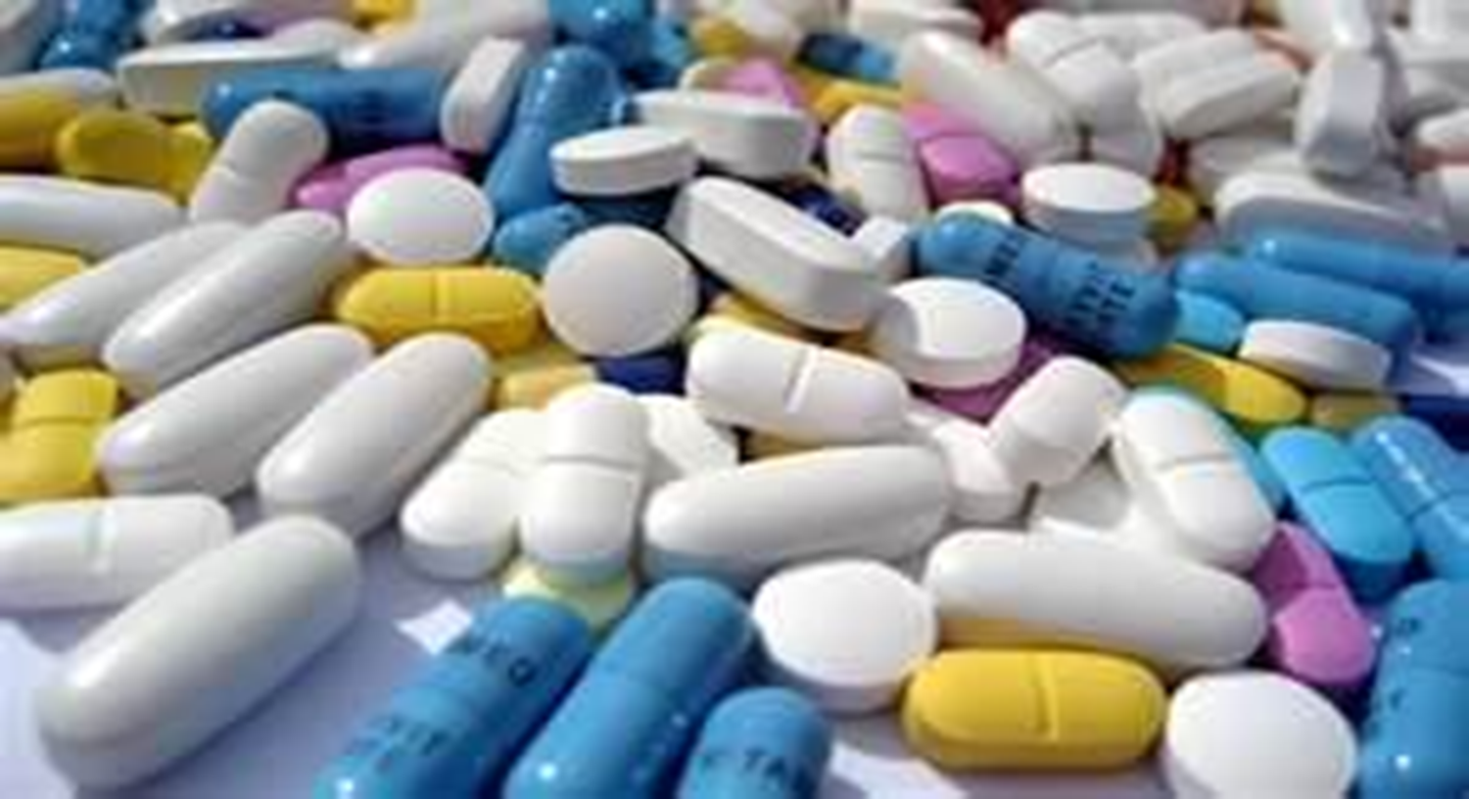
Withdrawal from Opiates, Benzodiazepine and Barbiturates generally should be managed in a hospital or a medical unit with 24 hour nursing care
Notes:
Withdrawal is serious, under medical supervision,
mixing of drugs i.e. opiates and other C.N.D.’s

Slide 37
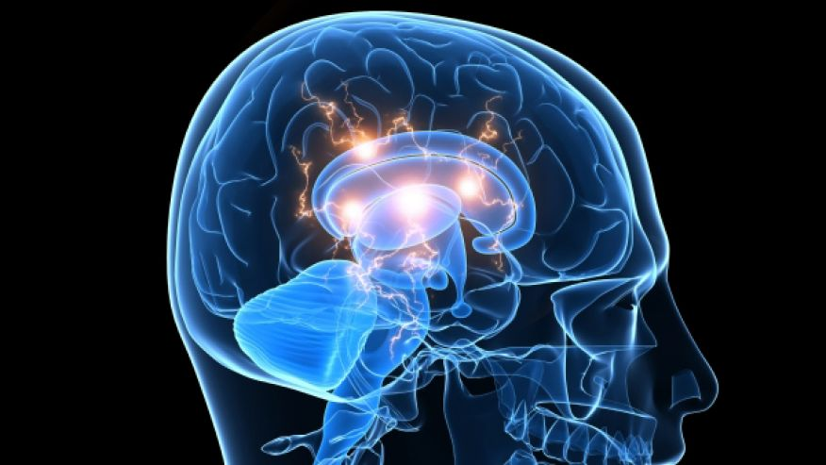
Stimulants
Increase the activity of the sympathetic nervous system and produces a sense of euphoria or hyper-vigilance.
Used therapeutically to increase alertness and as recreational drugs.
Used and sometimes abused to boost endurance and productivity as well as to suppress appetite.
Includes - caffeine, nicotine, methamphetamines, amphetamines, cocaine and cathinones (organic and synthetic)
Notes:
Synthetic cathinones are commonly known as “bath salts”
Organic cathinone is found in the Khat plant but is rarely seen locally but there are reports of the drug in Boston. Primarily found in the Arabian Peninsula and East Africa or in areas of the USA with large populations of people from those regions.
The Somali pirates in “Captain Phillips” were using Khat.

Slide 38
CNSS Withdrawal
Stimulants
May cause delusions, hallucinations
Use produces the following symptoms:
excitement, wakefulness, alertness, temporary rise in blood pressure and respiration
Notes:
While not considered “physically addictive” the depression that accompanies withdrawal can be significant.
Detox can be done on segregation unit, med units, intake unit

Slide 39
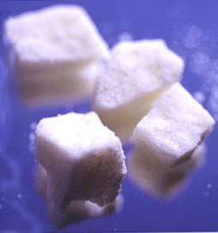
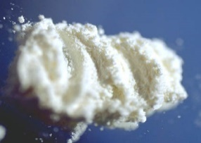
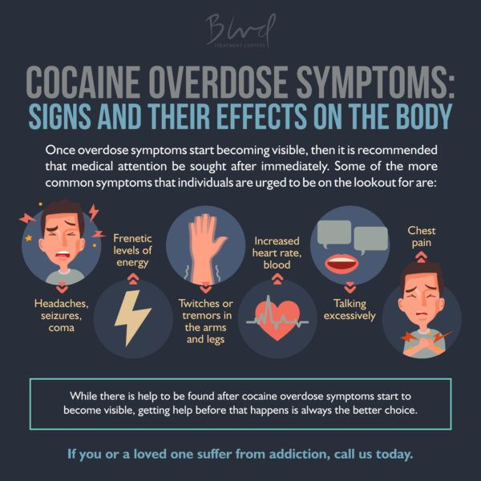
CNSS Withdrawal
Cocaine Withdrawal
agitation
depression/anxiety
intense craving
extreme fatigue
angry outbursts
lack of motivation
nausea/vomiting
shaking
irritability
muscle pain
disturbed sleep
formication
Notes:
Can be done on segregation unit, med units, intake unit

Slide 40
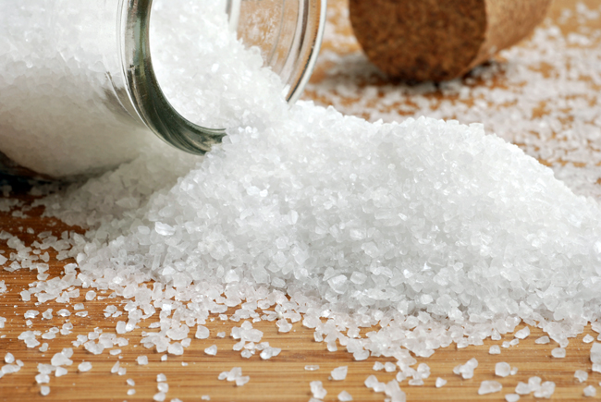
CNSS Withdrawal
Amphetamine/Methamphetamine/Cathinone
Withdrawal
moderate to severe depression/anxiety
sweating and/or rapid pulse
increased shakiness
exhaustion/insomnia
very deep or disturbed sleep
psychotic reactions including hallucinations (auditory, visual and formication)
mental confusion
suicidal/homicidal ideation
Jumpiness/restlessness/irritability
convulsions
craving
intense hunger
Notes:
Can be done on segregation unit, med units, intake unnit

Slide 41
Cocaine & Alcohol
Cocaine is particularly dangerous to use with alcohol, as the combination produces a powerful toxin in the body called cocaethylene. Cocaethylene is eliminated even slower from the body than cocaine and can intensify the cardiotoxic effects, for example by further increasing the heart rate and enhancing the concentration of cocaine in the bloodstream

Slide 42
Cocaine & Heroin
Another specific combination that can quickly be fatal is that of cocaine and heroin, also known as a “speedball.” Both of these substances have very powerful opposing effects, which may cause the subjective effects of each drug seem less intense. This can lead the user to take very high or unpredictable doses, thereby increasing their risk of lethal overdose.

Slide 43
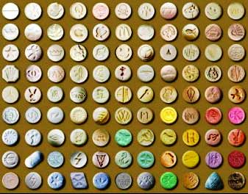
MDMA
Notes:
AKA – “E”, “X”, Ecstasy, Molly
Can be done on segregation unit, med units, intake unit
Depersonalization – a state in which one’s thoughts and feelings seem unreal or not to belong to oneself, or in which one loses all sense of identity.
De-realization – a feeling that one’s surroundings are not real, especially as a symptom of mental disturbance

Slide 44
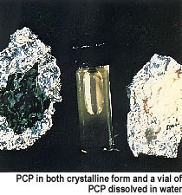
Psychedelics
Three broad categories:
hallucinogens, dissociatives, and entactogens/entheogens.
Subjective changes in perception, thought, emotion and consciousness.
Unlike other drugs, hallucinogens do not merely amplify familiar states of mind, but rather induce experiences that are qualitatively different from those of ordinary consciousness.
These experiences are often compared to non-ordinary forms of consciousness such as trance, meditation, and dreams
Phencyclidine- PCP (phenylcyclohexylpiperidine), is a dissociative drug formerly used as an anesthetic agent, exhibiting hallucinogenic and neurotoxic effects.
Angel Dust,
Rocket Fuel,
Wet,
Sherm,
Heemie,
Embalming Fluid,
many other names.
Notes:
Entactogens = to touch within… create a sense of deep communion
Entheogens = the god within. Said to create a deeply spiritual experience

Slide 45
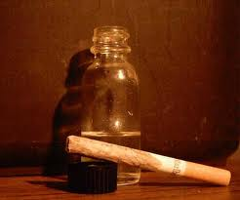
Psychedelics
PCP is stored in the brain for up to 2 weeks
effects include:
extreme slowness of thoughts, words and actions
staggering and balance problems
slow and strange speech
numbness, nausea, vomiting
profuse sweating, hallucination
involuntary eye movement
double vision
Chronic use of PCP can cause a toxic psychosis that can take days or weeks to clear.
No specific acute withdrawal symptoms

Slide 46
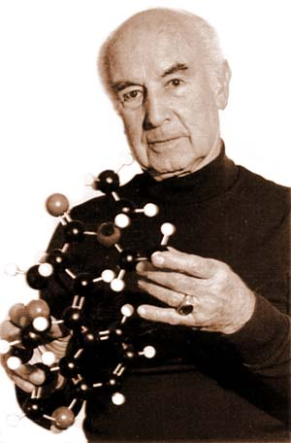
Psychedelics
Other psychedelic drugs include
LSD
Psilocybin (mushrooms)
Mescaline
DMT
Ketamine
Nitrous Oxide
DXM
“Designer Drugs”
Hoffman synthesized LSD in 1938

Slide 47
Important to note...
Amphetamines and Psychedelics can cause psychotic reactions. Inmates under the influence of these drugs may become extremely violent and destructive.
Officers must know symptoms of these drugs and handle these individuals with caution.
Notes:
Always use a partner or a team when interacting with anyone suspected of being intoxicated
Don’t take chances

Slide 48
Thank you
Any Questions or Comments?

